Slide 1
Semantic Web
RDF, RDFS, OWL, SPARQL, WoT etc.
In Small, Chewable Pieces
(with your breakfast)

Slide 2
Knowledge
Subject
Object
Hubert
Ferrari F430
Owns a
Predicate

Slide 3
Knowledge
Italy
Buchs
King of
Made in
Hubert
Ferrari F430
Owns a
Engine
Is feared in
Is a
Is feared in
Has a
France
Car
UK

Slide 4

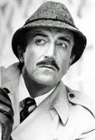

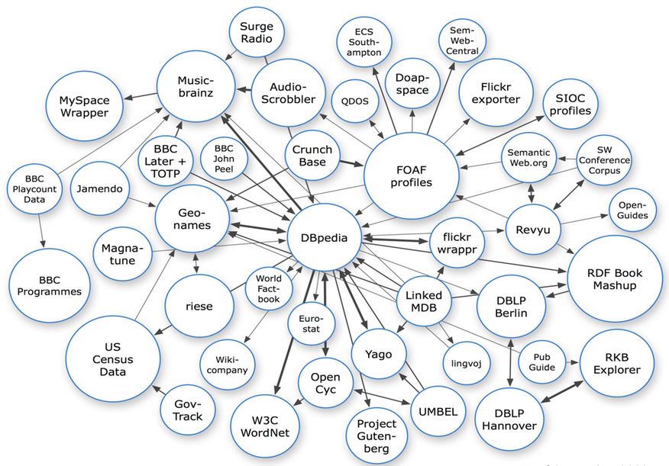

Machine-Readable Knowledge
Hubert, the king of Buchs, feared in ..
Hubert, le roi de Buchs, craignait ..
Tightly coupled vertical silos of knowledge.
Except, maybe in Clouseau’s case.
In natural language
<story lang=en-GB>
<person name=Hubert loc=Buchs>
<fearedIn location=..>
In your own encoding
Allow your knowledge to become discoverable and available for reasoning.
i.e. Les raisonnables
Using web technologies

Slide 5
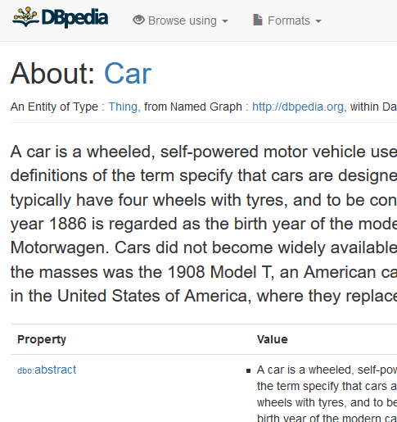
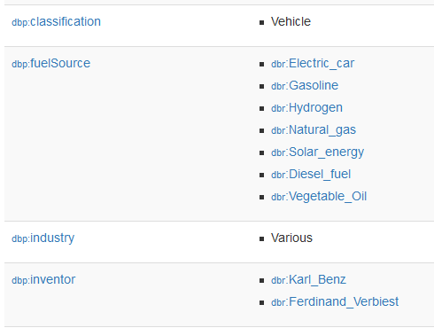
RDF
http://dbpedia.org/owns
Hubert
Ferrari F430
Owns a
urn:hubert-the-king
http://ferrari.com/F430
urn:Hubert-the-king http://dbpedia.org/owns http://ferrari.com/812
urn:Hubert-the-king dbo:Royalty wikidata:Q68277
…
<rdf:RDF
xmlns:rdf="http://www.w3.org/1999/02/22-rdf-syntax-ns#"
xmlns:dbo=“https://dppedia.org/#”
xmlns:wiki=“https://www.wikidata.org/wiki/#”>
<rdf:Description rdf:about=“urn:Hubert-">
<dbo:Royalty>wiki:Q68277</dbo:Royalty>
…
</rdf:Description>
</rdf:RDF>

Slide 6
RDF Knowledgebase
King
rdf:type
http://dbpedia.org/owns
Hubert
Ferrari F430
Owns a
Human
rdf:type
Knowledge through linking of terms (hence Linked Data)

Slide 7
RDFS – Extra Knowledge
Human
rdfs:subClassOf
Property: http://dbpedia.org/owns
King
rdfs:subPropertyOf
Property: http://myvocab.com/sole_owner
rdf:type
Hubert
Ferrari F430

Slide 8
OWL – Knowledge is Complex(ity)
Human
Property: http://dbpedia.org/owner
Vehicle
domain
owl:InverseOf
range
rdfs:subClassOf
Property: http://dbpedia.org/owns
rdfs:subClassOf
King
rdfs:subPropertyOf
Car
Property: http://myvocab.com/sole_owner
rdf:type
Hubert
Ferrari F430
rdf:type
urn:hubert-the-king
http://dbpedia.org/page/Ferrari_F430

Slide 9
OWL – Knowledge is Complex(ity)
Country
Human
x:RulerOf
Vehicle
F430
owl:sameAs
rdfs:subClassOf
rdfs:subClassOf
http://wikidata.org/F430
King
Car
Property: http://myvocab.com/sole_owner
rdf:type
Hubert
Ferrari F430
rdf:type
urn:hubert-the-king
http://dbpedia.org/page/Ferrari_F430

Slide 10
OWL – Meta Knowledge
hilti:CordlessDrill owl:UnionOf (hilti:BatteryPoweredTool, hilti:DrillingTool)
bosch:BatteryPoweredDrill owl:EquivalentClass (hilti:CordlessDrill)
Yes, but hilti:CordlessDrill is better
hilti:GrindingTool owl:DisjointWith (hilti:VaccumCleaner)
hilti:CordlessTool owl:ComplementOf (hilti:MainsPoweredTool)
hilti:Insert owl:Symmetric (hilti:Fits) (hilti:Tool) => (hilti:Tool) hilti:Fits (hilti:Insert)
hilti:BX3ME owl:Transitive (hilti:CompatibleWith) (hilti:X-SB3MX)
hilti:X-SB3MX hilti:CanBeUsedOn BIM:BrickWall
=> (hilti:BX3ME) hilti:CanBeUsedOn BIM:BrickWall
This only the tip of the iceberg. The wikidata:RMS_Titanic is underneath.

Slide 11

Nice, but why?
Enables inference based on first order logic
All men are mortal
Socrates is a man
Therefore, Socrates is mortal
All fastening tools are dangerous
BX 3-ME is a fastner
Therefore, BX 3-ME is the weapon of choice for Hubert!

Slide 12
SPARQL (sparkle)
Relational Databases store Tuples -> Query using SQL
Document Databases (NoSQL) store documents (uh?)- > Query using content find
Object Databases stores serialized objects -> Query using property and type relationships
RDF Databases stores Triples -> Query using patterns!
SPARQL Client
SELECT ?tool
WHERE {
?tool rdfs:subClassOf hilti:CordlessTool.
}
Request response in JSON (SPARQL REST API)
SPARQL Engine
Triple Store

Slide 13
SPARQL (sparkle)
Looking for something? That’s just a query away.
SELECT ?tool
WHERE {
?tool rdfs:subClassOf hilti:CordlessTool.
?tool hitli:Fits ?fastner.
?fastner a hilti:Fastener.
?fastner hitli:CanBeUsedOn BIM:BrickWall
}
Don’t know what you are looking for? That needs reasoning.
SELECT ?tool
WHERE {
?tool rdfs:subClassOf hilti:FasteningTool.
?tool hitli:CanBeUsedOn BIM:BrickWall
}

Slide 14
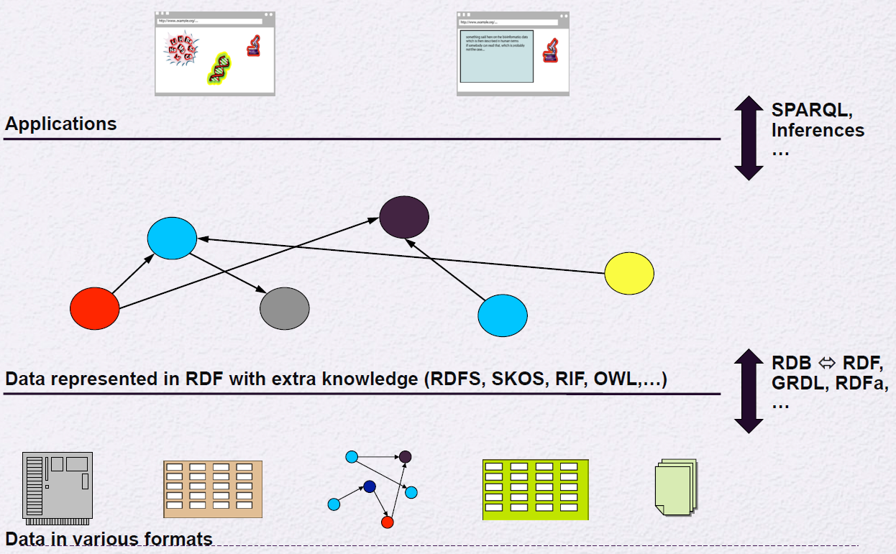
The Big Picture
Image borrowed from w3c.org

Slide 15
if audience.isYawning
skip_slides(2)

Slide 16
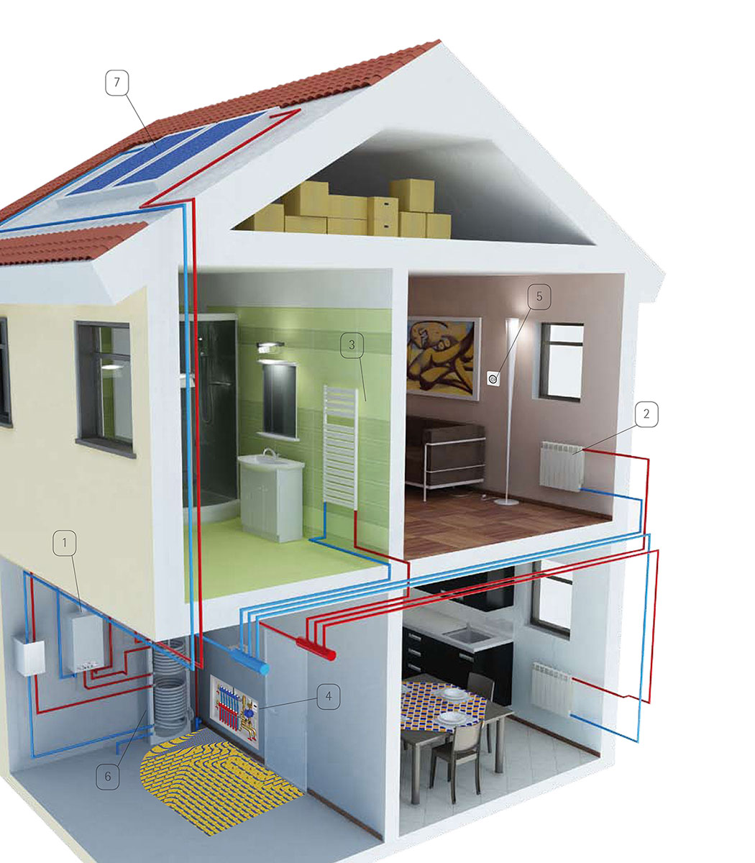
Organizing Knowledge

Slide 17

Nerd Alert!
Logical consequence and Entailment
A Thermostat is_a HeatingController
Therefore, Thermostat controls_heating_of a Room
All HeatingControllers are Controllers
All Thermostats are HeatingController
Therefore, all Thermostats are Controllers
This is Semantic consequence (⊨), i.e. If A is true, then B is also true.
A Thermostat is_a HeatingController
All HeatingContllers are Controllers
A Controller is_contained_in a Space
LivingRoom is_a Space
Therefore, Thermostat controls_heating_of LivingRoom
Using RDF we can reason about the system!
Is the RoomTemperature of my LivingRoom dependent on the OutletTemperature of the SolarWaterHeater?
This is Syntactic consequence (⊢), i.e. A proves B.

Slide 18
Web of Things
Thing Description
Security
Enable Interoperable Things
Protocol Bindings and Discovery
Scripting API

Slide 19

Things = Knowledge
{
"@context": [ "http://w3c.github.io/wot/w3c-wot-td-context.jsonld", { “Lighting": "http://example.org/lights#" } ],
"@type": “LEDColorLamp",
"name": "MyLEDThing",
“location": “SRE:ch/zg/zw09/478",
"uris": "http://lamp1/" ,
"encodings": [ "JSON","EXI"],
"security": { "cat": "token:jwt", "alg": "HS256", "as": "https://authority-issuing.example.org" },
"properties": [
{
"@type": “Lighting:LightColor",
"name": "status",
"valueType": { "type": "integer" },
"writable": true,
"hrefs": “color"
}
],
"actions": [
{
"@type": “Lighting:FadeCommand",
"name": "fadeIn",
"inputData": { "valueType": { "type": “object“, “properties”:[“duration”:{“type”:”integer”}] }},
“outputData": {“Lighting:FadeMonitor "}
"hrefs": “fade”
}
]
LEDColorLamp
LightColor
Type
URI
http://lamp1
Location
«Room 478»
Color
Type
valueType
integer
href
color
Fade
inputData
object
outputData
object
Failure
inputData
object

Slide 20
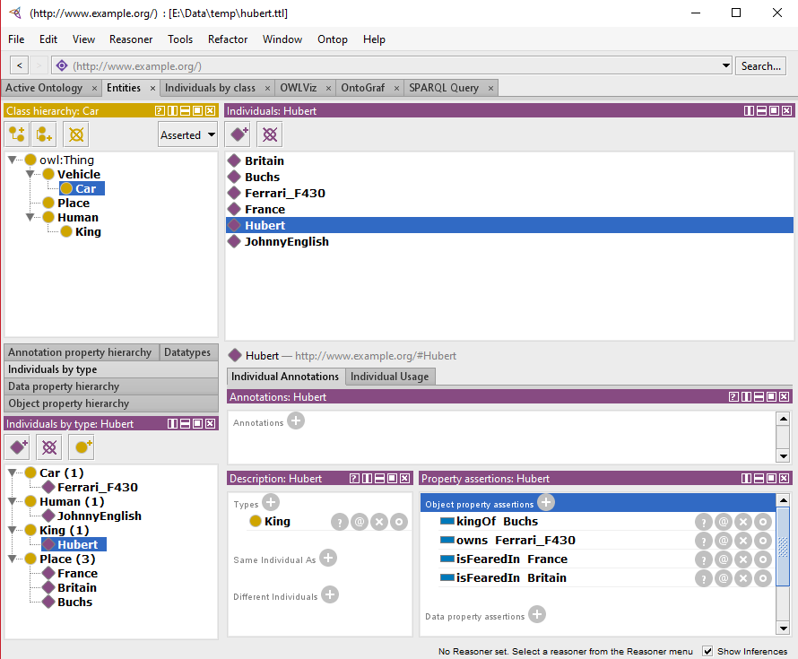
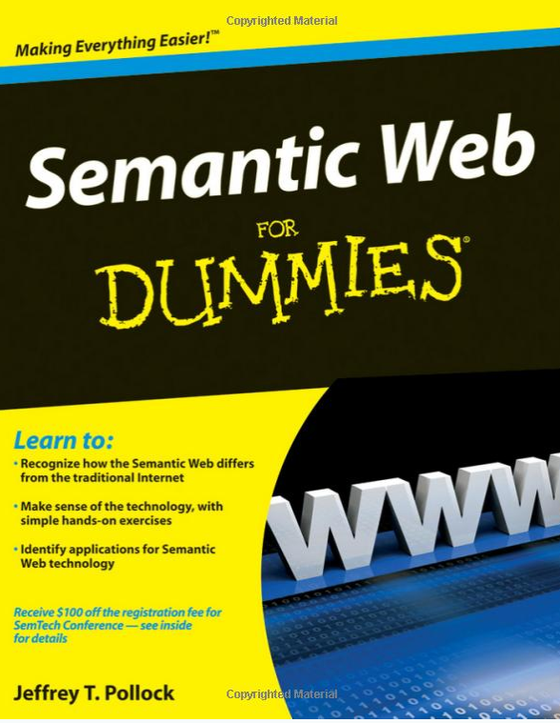
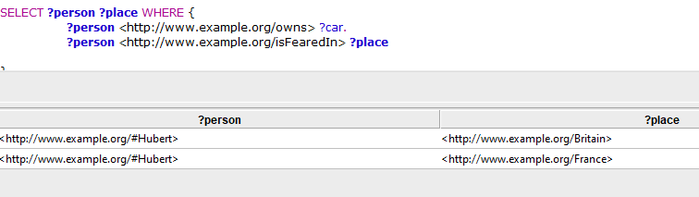
Digestable?
est-ce digestible?
Get the tutorial OWL data from https://github.com/ganesheth/learning-semantic-web

Slide 21
Thank you

